Slide 1

Registration Desk
Pick up your conference badge & materials in the Hall BC Foyer, Convention Center
Sunday 10:00 a.m. – 7:00 p.m.
Monday 7:15 a.m. – 5:30 p.m.
Tuesday 7:15 a.m. – 5:30 p.m.
Wednesday 7:30 a.m. – 5:30 p.m.

Slide 2
Complimentary Coat Check
Conference Room West
Near Rooms 108-109
Monday 7:00 a.m. – 5:30 p.m.
Tuesday 7:15 a.m. – 6:15 p.m.
Wednesday 7:30 a.m. – 5:15 p.m.

Slide 3
Sunday
Registration/Information Desk 10:00 a.m. – 7:00 p.m. Hall BC Foyer Orientation for First-Time 4:00 p.m. – 5:00 p.m.
Attendees Room 120, ICC Welcome Reception 5:30 p.m. – 7:00 p.m. White River Ballroom,
JW Marriott Hotel

Slide 4
Monday
Registration/Information Desk 7:15 a.m. – 5:30 p.m. Hall BC Foyer Continental Breakfast 7:15 a.m. – 8:00 a.m. Sagamore Ballroom
General Session 8:00 a.m. – 9:15 a.m. Sagamore Ballroom
Insurance Services Expo 9:30 a.m. – 5:00 p.m. Halls ABC
Refreshment Break 9:30 a.m. – 10:30 a.m.
with Exhibitors Halls ABC
PLRB Presents! 10:30 a.m. – 5:15 p.m. Room 117, ICC

Slide 5
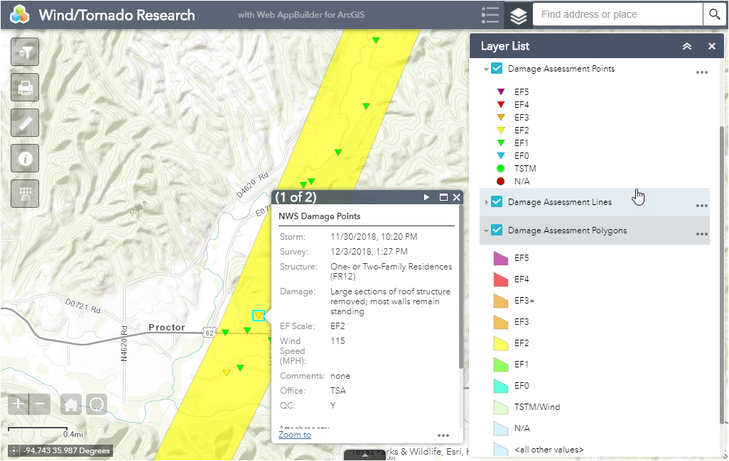
Monday
CAT Management: Advanced Mapping Technologies/GIS
Room 116, ICC
3:30 p.m. – 4:30 p.m.
Peter J. Balingit, GISP, AVP-Catastrophe Services, PLRB
Andrew Louchios, GISP, IT/Geospatial Specialist, PLRB

Slide 6
Monday
Complimentary Buffet Lunch 12:00 p.m. – 1:30 p.m. with Exhibitors
Halls ABC
Afternoon Educational Sessions 1:30 p.m. – 5:00 p.m. ICC Meeting Rooms
Earthquake Certification Program 1:30 p.m. – 3:00 p.m.
(Two Sessions) 3:30 p.m. – 5:00 p.m. Sagamore 7
Refreshment Break 3:00 p.m. – 3:30 p.m.
with Exhibitors Halls ABC

Slide 7
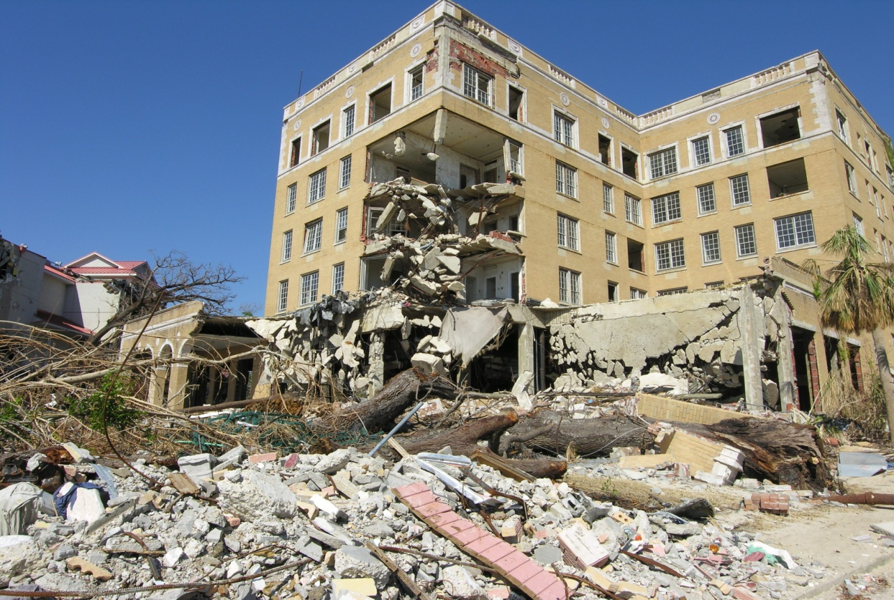
Monday
Earthquake Certification Program
Sagamore 7
Two Sessions:
1:30 p.m. – 3:00 p.m. and 3:30 p.m. – 5:00 p.m.

Slide 8
Tuesday
Registration/Information Desk 7:15 a.m. – 5:30 p.m. Hall BC Foyer
Continental Breakfast 7:15 a.m. – 8:00 a.m. Sagamore Ballroom
Educational Sessions 8:00 a.m. – 12:00 p.m. ICC Meeting Rooms
PLRB Presents! 8:30 a.m. – 4:30 p.m. Room 117, ICC
Insurance Services Expo 9:30 a.m. – 6:00 p.m. Halls ABC
Coffee Break with Exhibitors 9:30 a.m. – 10:30 a.m.
Halls ABC

Slide 9

Tuesday
Online Coverage Research
Room 116, ICC
10:30 a.m. – 12:00 p.m.
Patrick K. Biggins, JD, Counsel, PLRB David W. Fox, JD, Counsel, PLRB

Slide 10
Tuesday
Complimentary Buffet Lunch 12:00 p.m. – 1:30 p.m. with Exhibitors
Halls ABC
Afternoon Educational Sessions 1:30 p.m. – 5:00 p.m. ICC Meeting Rooms
Refreshment Break 3:00 p.m. – 3:30 p.m.
with Exhibitors Halls ABC
Presenter Appreciation Reception 5:00 p.m. – 6:00 p.m.
with Exhibitors (Cash Bar)
Halls ABC
Insurance Services Expo Closes 6:00 p.m.

Slide 11
Tuesday
CAT Management: Advanced Mapping Technologies/GIS
Room 116, ICC
1:30 p.m. – 2:30 p.m.
Peter J. Balingit, GISP, AVP-Catastrophe Services, PLRB
Andrew Louchios, GISP, IT/Geospatial Specialist, PLRB

Slide 12
Wednesday
Registration/Information Desk 7:30 a.m. – 5:30 p.m. Hall BC Foyer Continental Breakfast 7:30 a.m. – 8:30 a.m. Sagamore Ballroom
Morning Educational Sessions 8:30 a.m. – 12:00 p.m. ICC Meeting Rooms
Refreshment Break 10:00 a.m. – 10:30 a.m.
Wabash Foyers

Slide 13
Wednesday
Online Coverage Research
Room 116, ICC
10:30 a.m. – 12:00 p.m.
Patrick K. Biggins, JD, Counsel, PLRB David W. Fox, JD, Counsel, PLRB

Slide 14
Wednesday
Lunchtime Presentation 12:00 p.m. – 1:30 p.m. “The Five Tools For Your Life’s Toolbox”
Sagamore Ballroom
Afternoon Educational Sessions 1:30 p.m. – 5:00 p.m. ICC Meeting Rooms
Refreshment Break 3:00 p.m. – 3:30 p.m.
Wabash Foyers

Slide 15


Thank You
for attending the
2019 Claims Conference & Insurance Services Expo

